Slide 1
How to use BSA BLE applications
APR, 2014

Slide 2
App_ble application
- BSA GATT API

Slide 3
App_ble application
This application explains
- How to use BSA BLE Client API/EVENTs
- How to use BSA BLE Server API/EVENTs

Slide 4
App_ble application(BLE server side)
This application has below menus
Register server app, Deregister server app
register/deregister an UUID value for a server application
Create service
create a service which will be included in a server application
Add character
add a character to a service
Start service
Configure BLE Advertisement data
Display Servers
- show server’s service and characteristics

Slide 5
App_ble application(how to test BSA BLE SERVER API)
Step 1. Execute bsa_server & app_manager & app_ble
Step 2. Go to app_ble menu
Step 3. Register server app
**** Bluetooth Low Energy Server menu ****
27 => Register server app
28 => Deregister server app
29 => Create service
30 => Add character
31 => Start service
32 => Configure BLE Advertisement data
33 => Display Servers
99 => QUIT
Select action => 27
Bluetooth BLE register menu:Register app UUID(eg. x9999) => x9000

Slide 6
App_ble application(how to test BSA BLE SERVER API)
Step 4. Create service
**** Bluetooth Low Energy Server menu ****
29 => Create service
Select action => 29
Select Server:
*************** BLE SERVER LIST *****************
0:BLE Server server_if:5
*************** BLE SERVER LIST END *************
Select => 0
Enter Service UUID to create(eg. x180A) => xa100
Enter instance number to create(should be bigger than 0, Eg:1) => 1
Enter number of handles to create(should be bigger than 0, Eg:10) => 5
Select primary(1) or not(0) => 1
Enter attribute number => 1

Slide 7
App_ble application(how to test BSA BLE SERVER API)
Step 5. Add character
**** Bluetooth Low Energy Server menu ****
30 => Add character
Select action => 30
Select Server:
*************** BLE SERVER LIST *****************
0:BLE Server server_if:5
1:uuid:0xa100, handle:5, id:1, is_pri:1, service_id:40
*************** BLE SERVER LIST END *************
Select => 0
Select attribute numberSelect => 1
Add char UUID(eg. x9999) => xa111
BSA_trace 17@ 01/04 07h:12m:51s:429ms: BSA_BleSeAddCharInit
Enter Attribute Permissions[Eg: Read-0x1, Write-0x10, Read|Write-0x11]
Enter => x1
Enter Characterisic Properties Eg: WRITE-0x08, READ-0x02, Notify-0x10, Indicate-0x20
Eg: For READ|WRITE|NOTIFY|INDICATE enter 0x3A
Enter => x20

Slide 8
App_ble application(how to test BSA BLE SERVER API)
Step 6. Start service
**** Bluetooth Low Energy Server menu ****
31 => Start service
Select action => 31
Select Server:
*************** BLE SERVER LIST *****************
0:BLE Server server_if:5
1:uuid:0xa100, handle:5, id:1, is_pri:1, service_id:40
*************** BLE SERVER LIST END *************
Select => 0
Select attribute number
Select => 1
Step 7. make discoverable/connectable. Go to app_manager.
Select 15 => Ser device BLE visibility

Slide 9
App_ble application(how to test BSA BLE SERVER API)
Then, simple BLE server started & discovered by ble client.
This simple server has
A service with 0xA100 UUID1
This service has a characteristic (0xA111 UUID, read)

Slide 10
App_ble application(BLE client side)
This application has below menus
**** Bluetooth Low Energy Client menu ****
7 => Register client app
8 => Deregister Client app
9 => Connect to Server
10 => Close Connection
11 => Read information
12 => Write information
13 => Service Discovery
14 => Register Notification
15 => Deregister Notification
16 => Display Clients
….

Slide 11
App_ble application(BLE client side)
Simple test step
Step 1. execute bsa_server & app_manager & app_ble
Step 2. go to app_ble menu
Step 3. do discovery “2 => Start BLE Discovery”
Step 4. connect to server “9 => Connect to Server”
Step 5. check server’s service and char “16 => Display Clients”
Step 6. read/write characteristic

Slide 12
hogp application

Slide 13
How to use BSA HOGP APPlication
Step1. Execute bsa_server, app_manager, app_hh, app_ble.
“app_ble” was needed for BLE Cache save & load.
Step2. Go to app_hh menu, do “4 => BLE Discovery”
Step3. Go to app_hh menu, do “6 => HID Connect (Report mode)”

Slide 14
How to use HOGP with find me application
Step1. Execute bsa_server, app_manager, app_hh, app_ble_pm.
“app_ble_pm” handles BLE cache load & save
Step2. Go to app_ble_pm menu, do “1 => Register Proximity Monitor”
Step3. Go to app_hh menu, do “4 => BLE Discovery”
Step4. Go to app_hh menu, do “6 => HID Connect (Report mode)”
Step5. Go to app_ble_pm menu, do “4 => Connect Proximity Reporter”
Select “0” for Device from XML database
Select dev number to connect
Select client number, “0”
Select Direct connection “1”.
This step create a path to write / read BLE characteristic from app_ble_pm.
Step6. Go to app_ble_pm menu, do “9 => Configure Immediate Alert Level”
We can configure alert level as find me profile

Slide 15
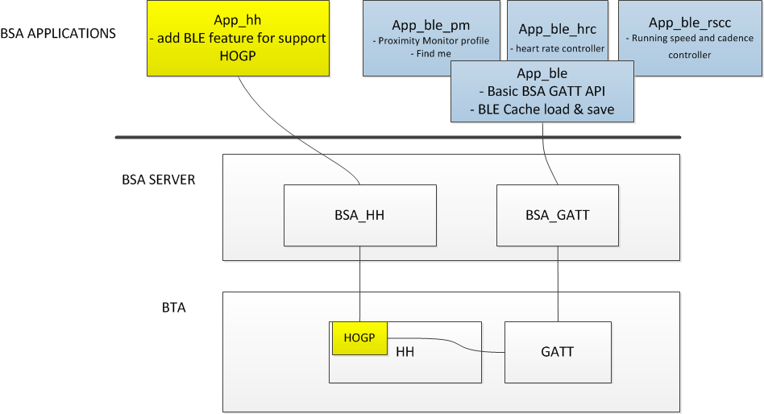
BSA gatt & HOGP & ble profile location

Slide 16
BLE cache handling
During creating BLE connection,
1. By default, BT stack(bsa_server) creates/sends BSA_BLE_CO_CACHE_LOAD_EVT to application(app_ble)
2. Then, application(app_ble) checks cache file(bt_ble_client_devices.xml),
3. if we already have information on cache, then app_bles load cache information to BT stack(bsa_server).
4. After this, BT stack does not create BSA_BLE_CL_CACHE_SAVE_EVT to application(app_ble).
However, in step 2, if application does not have any information of BLE device, then app_ble just return with no information.
Then, BT stack asks peer BLE device’s information.
Then, BT stack creates/sends BSA_BLE_CL_CACHE_SAVE_EVT to application(app_ble) with BLE device’s information.

Slide 17
HOGP and other ble profiles
BLE profiles on bsa application layer(app_ble_pm, app_ble_blp, app_ble_cscc, app_ble_htp, app_ble_rscc) use BSA GATT API.
Normally, server interface is created by these applications, so application can know server interface which they create.
However, HOGP(BLE HID Device) was implemented on BTA layer(in the bsa_server). This was developed by BT stack team, but BLE cache handling was needed in this case also.
So, server interface was created by HOGP in BTA layer, application(app_ble) cannot know this.
In this situation, we need to handle cache data in app_ble(or any of ble profiles on top of BSA).

